Slide 1
UNIT III: STATIC MAGNETIC FIELDS
Presentation by
Dr. Rajasi Mandal
Assistant Professor
EEE
SSN College of Engineering

Slide 2
Session Objectives
  To study the concepts of magnetostatic fields, magnetic flux density, vector potential, Biot-Savart’s and Ampere’s laws, and its applications.

Slide 3
Session Outcomes
  Students will be able to explain and apply the concepts of static magnetic fields. (CO3)

Slide 4
Session Outline
  Equation of Continuity: Conservation of Charges
  Magnetic Field of Induction or Magnetic Flux Density
  Magnetic Field Intensity
  Lorentz Force: Force on a Charge in Electric and Magnetic Fields
  Force on a Current carrying Conductor in a Magnetic Field
  Biot-Savart’s Law
  Ampere’s Law
  Applications of Ampere’s Law
  Force between 2 Parallel Current carrying Conductors
  Magnetic Flux
  Gauss’s Law in Magnetostatics
  Magnetic Scalar Potential and Magnetic Vector Potential
  Poisson’s Equation and Laplace’s Equation
  Calculation of Inductance, Energy, Energy Density for Inductors
  Comparison between Static Electric Field and Static Magnetic Field

Slide 5
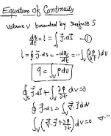

Equation of Continuity: Conservation of Charges
Significance of Equation of Continuity:
The equation of continuity gives a relation between the current density, J and the charge density, ρ.
The equation implies that the rate of decrease of charge inside the volume of a conductor with respect to time is equal to the flow of charge through the surface enclosing the volume.
Hence, the equation of continuity indicates the conservation of charges.

Slide 6
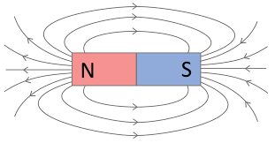
Magnetic Field of Induction or Magnetic Flux Density
Magnetic flux density is defined as the total number of lines of magnetic induction (or magnetic flux) passing per unit area through a surface. So, magnetic flux density, B is also defined as magnetic flux per unit area.
The unit of B is Tesla (T) or Weber/Meter² (Wb/m²).
Magnetic field intensity, H is defined as the ratio of the MMF needed to create a certain flux density, B within a particular material per unit length of that material.
⸫ B = μ₀ H
The unit of H is Ampere/Meter (A/m).
Magnetic Field Intensity
Magnetic Field Lines

Slide 7
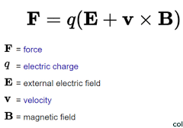
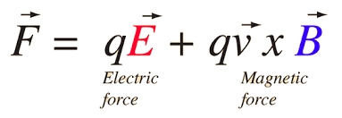
Lorentz Force: Force on a Charge in Electric and Magnetic Fields
Practice Problem 1 If a charged particle of 0.4 C is moving with a velocity 4i-j+2k m/s through an electric field E=10i+10k and magnetic field of induction B=2i-6j-6k then calculate the following: (i) the force experienced by the particle in electric field, (ii) the force experienced by the particle in magnetic field, (iii) the total Lorentz Force.

Slide 8
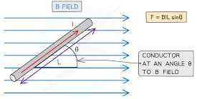
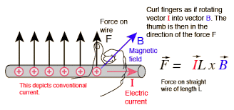
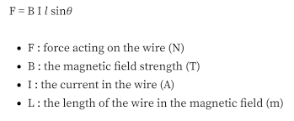
Force on a Current carrying Conductor in a Magnetic Field

Slide 9
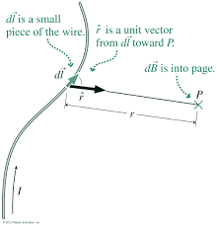
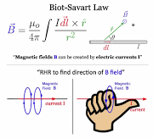
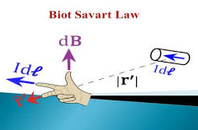
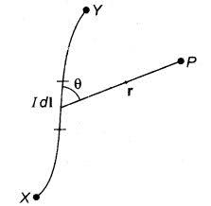
Biot Savart’s Law
dB α I dl sinθ / r²
Practice Problem 2 A straight segment of wire of 0.002m carries a current of 4A. Calculate the magnitude of the magnetic field of induction produced by it at a distance of 1.6m in a direction perpendicular to itself.

Slide 10
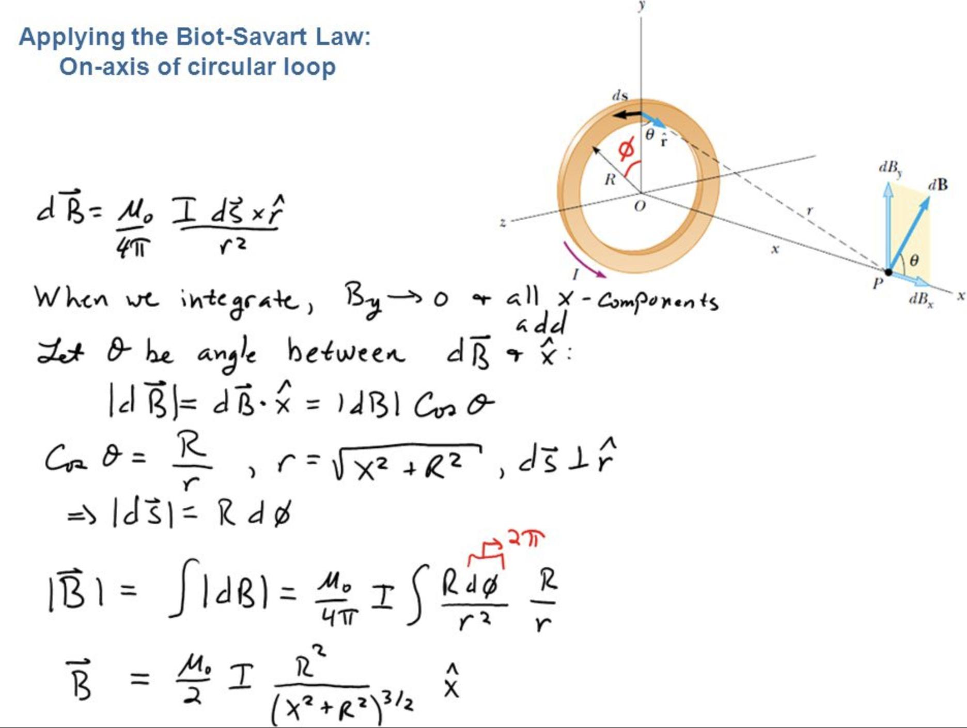
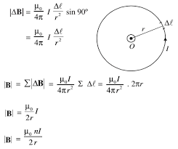
Applications of Biot Savart’s Law
Magnetic field of induction on the axis of a circular coil carrying current I
Magnetic field of induction at the centre of a circular coil carrying current I with n turns

Slide 11
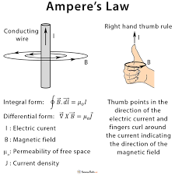
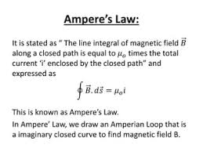
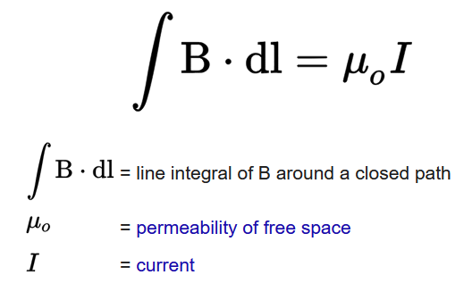

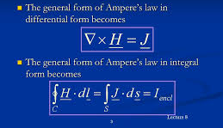
Ampere’s Law

Slide 12
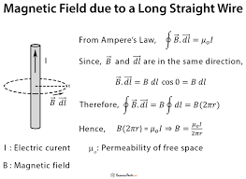
Applications of Ampere’s Law:
Magnetic field due to an infinitely long straight current carrying wire / conductor
Practice Problem 3 A straight wire carries a current of 4A. Find the magnitude and the direction of the magnetic field of induction due to current at a point 12cm away from the wire?
Practice Problem 4 Calculate the magnitude and the direction of the magnetic field intensity due to a long wire carrying a current of 10A at a distance 5cm from it.
Practice Problem 5 A horizontal overhead power line carries a current of 90A from East to West direction. What is the magnitude and the direction of the magnetic field of induction due to current at a point 1.6m below the overhead line?

Slide 13
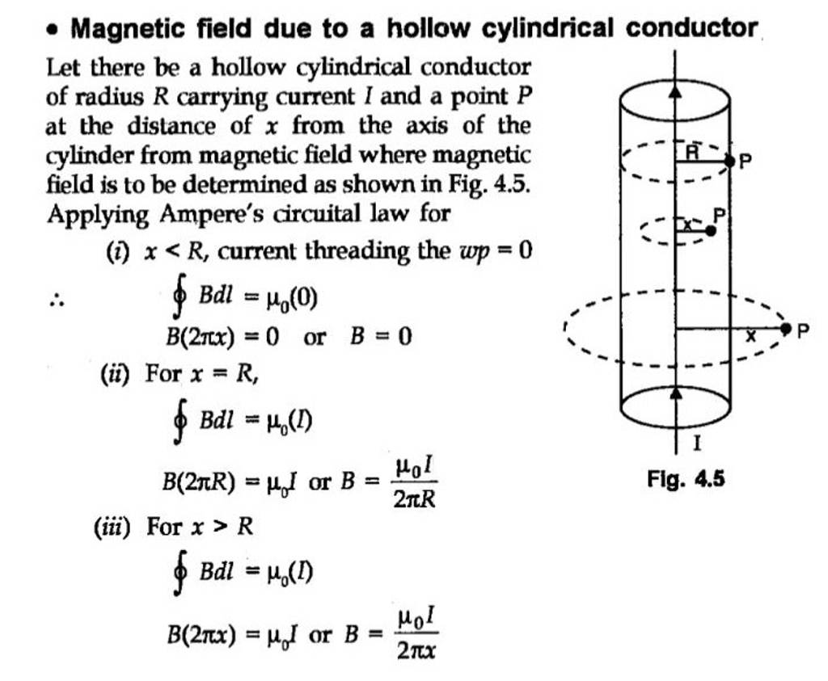
Applications of Ampere’s Law:
Magnetic field due to a hollow cylinder
Practice Problem 6 Calculate the magnetic field of induction and magnetic field intensity just outside and inside a hollow cylinder of radius 4 cm carrying a current of 50A.

Slide 14
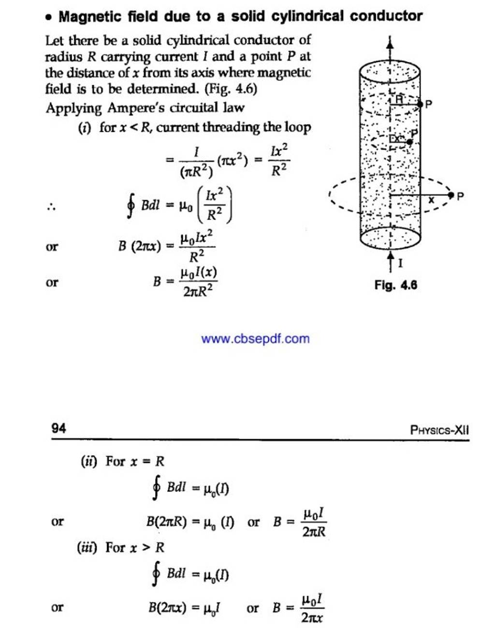
Applications of Ampere’s Law:
Magnetic field due to a solid cylinder

Slide 15
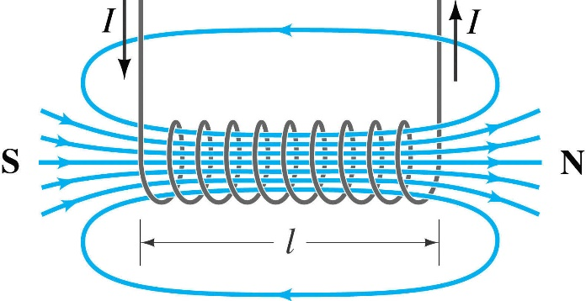
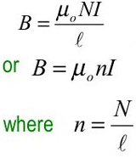
Applications of Ampere’s Law:
Magnetic field due to a solenoid
Practice Problem 7 The length of a solenoid is 0.30m and it has 180 turns. Find the magnetic field at the following positions if a 3A current flows through the solenoid:
in the interior or centre of the solenoid,
at the two extreme ends of the solenoid,
outside the solenoid.
Practice Problem 8 Calculate the magnetic field intensity along the axis of a solenoid carrying a current of 3A. The length of the solenoid is 1.5m and the total number of turns is 1500.
Practice Problem 9 A solenoid has 4 layers of 1200 turns each. It’s length and mean radius are 3m and 0.25m respectively. A current of 2.5A flows through the solenoid. Find the magnetic field and magnetic flux at the centre of the solenoid.
Practice Problem 10 A copper wire is wound very closely over a solenoid of length 40cm and radius 4cm. The radius and the resistance of the wire are 0.153cm and 0.002Ω/m respectively. The solenoid is connected across a 25V battery and the number of turns of the wire around the solenoid is 6/cm. Find the magnetic field strength within the solenoid.

Slide 16
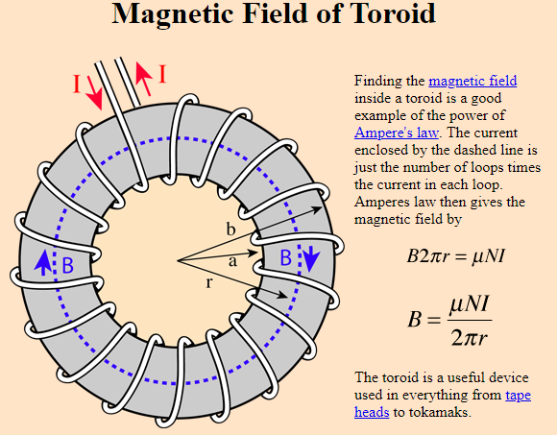
Applications of Ampere’s Law:
Magnetic field due to a toroid

Slide 17
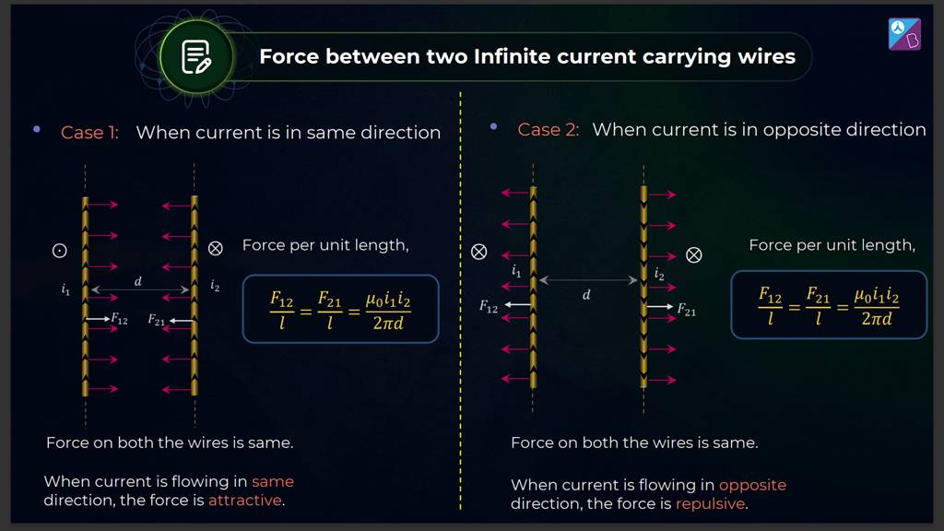
Force between 2 Parallel Current carrying Wires
Practice Problem 11 Calculate the force per unit length on a straight wire carrying current 3A due to another long parallel wire with current 4A at a separation of 3m. Find the nature of force for antiparallel direction of the current through these wires.

Slide 18
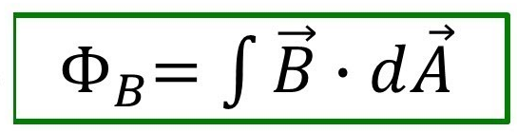
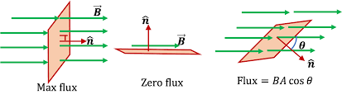
Magnetic Flux
Magnetic flux is defined as the number of magnetic field lines passing through a given surface.
The unit of ϕ_{B} is Weber (Wb).

Slide 19
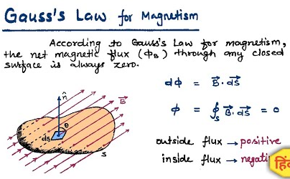
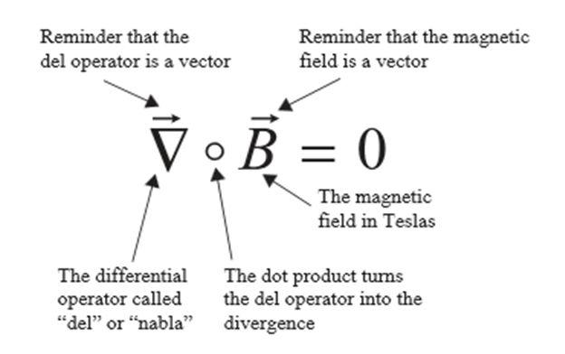
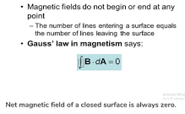
Gauss’s Law in Magnetostatics
The divergence of magnetic field is zero.
There is no source or sink for magnetic field lines.
Magnetic monopole does not exist.
The magnetic poles appear in pair only.

Slide 20
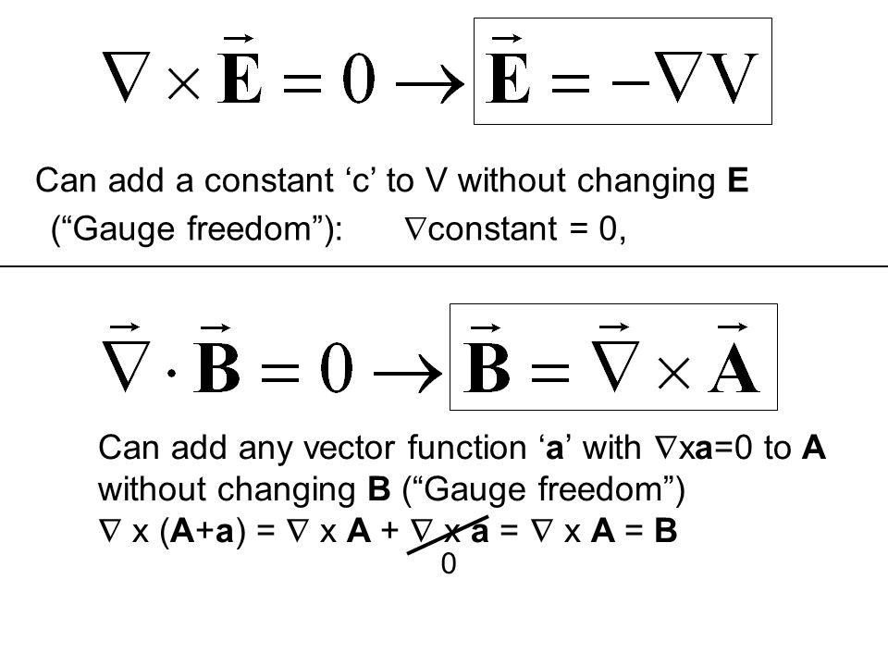
Scalar Potential and Vector Potential
If the curl of any vector is zero then there is a scalar whose gradient gives the given vector, and that scalar is called the scalar potential of a vector field. (Curl Grad ϕ = 0) e.g. Electrostatic scalar potential, V
If the divergence of any vector is zero then there is a vector whose curl operation gives the given vector, and that vector is called the vector potential of a vector field. (Div Curl Ā = 0) e.g. Magnetic vector potential, Ā

Slide 21
Magnetic Scalar Potential and Magnetic Vector Potential
The magnetic scalar potential, V_{m} is defined as a scalar function, the negative gradient of which gives the magnetic field of induction, B in a current-free space.
Magnetic vector potential, Ā is defined as the vector function, the curl of which gives the magnetic field of induction, B.
Practice Problem 12 If the magnetic scalar potential is given by ϕ_{m}=(x²+y²-z²) at any point (x,y,z) in a current-free region, then find the following:
The magnetic field at that point,
The magnetic field at (1,2,2).
Practice Problem 13 If the magnetic vector potential is given by Ā=(10x²+y²-z²)ĵ at any position, then find the following:
The magnetic field at that position,
The magnetic field at (1,1,1).

Slide 22
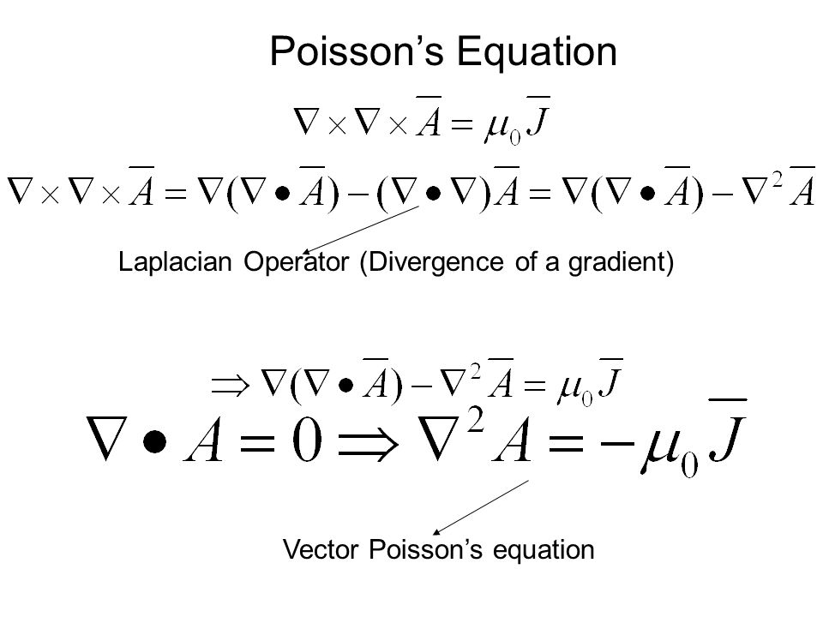
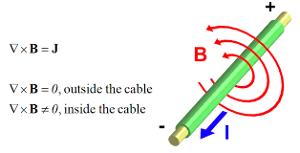
Poisson’s Equation and Laplace’s Equation
Using Ampere’s Law, µ₀ J or,
Laplace’s equation
For a current-free region, J=0, hence,

Slide 23
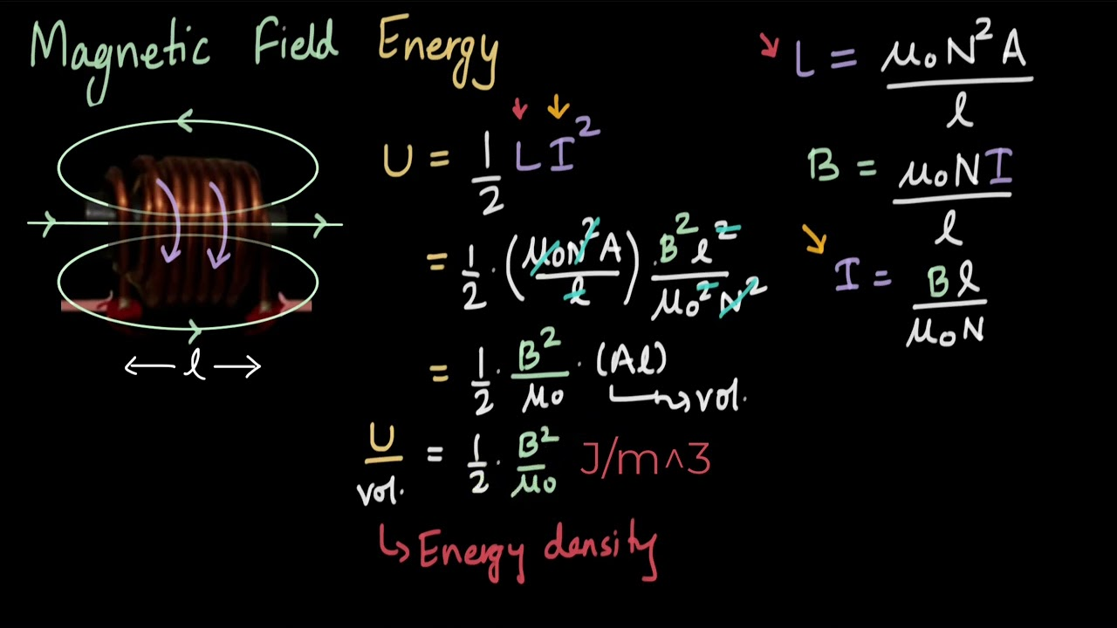
Calculation of Inductance, Energy, Energy Density
Inductance, L = μ₀ μ_{r} N² A / l
Energy, U = ½ L I².
Energy Density, U = ½ μ H².
Energy Density is defined as the total amount of energy in a system per unit volume.

Slide 24
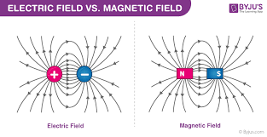

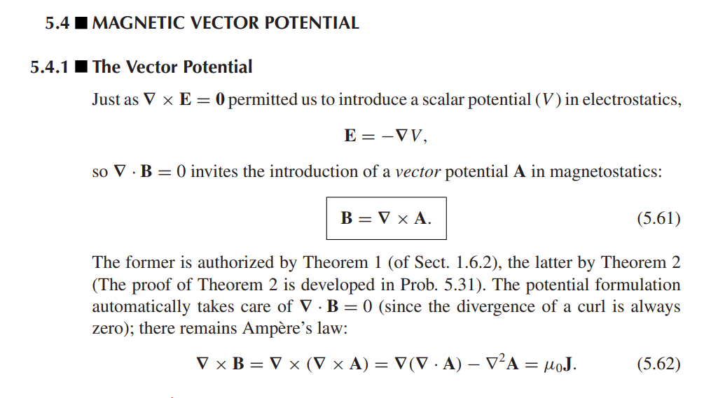
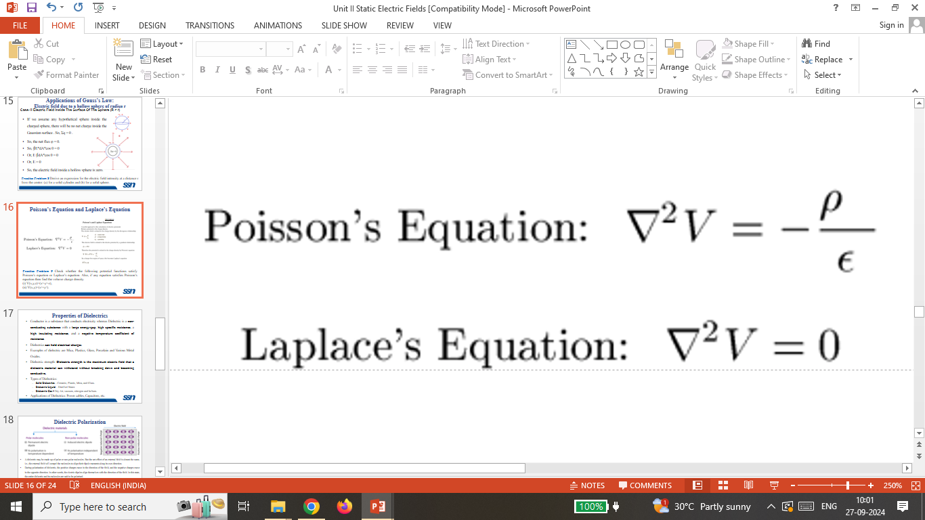
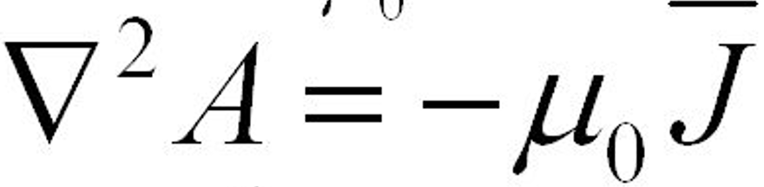
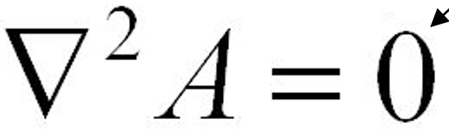
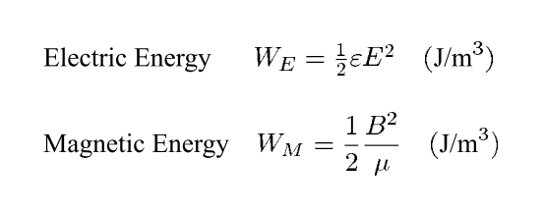
Comparison between Static Electric Field and Static Magnetic Field
 |  | Static Electric Field | Static Magnetic Field
1 | Reason | Static charges i.e. charges at rest | Uniformly moving charges i.e. steady current
2 | Field Lines | From positive charge to negative charge | From north pole to south pole
3 | Divergence
4 | Curl
5 | Lorentz Force | F_{e} = q E | F_{m} = q (v × B)
6 | Potential | Scalar Potential, V where, | Vector Potential, Ā where,
7 | Poisson’s Equation
8 | Laplace’s Equation
9 | Energy Density
0

Slide 25
Test Your Understanding
State and derive Ampere’s law in Magnetostatics. Using the Integral form of Gauss’s law, derive the Differential form of Gauss’s law.
State Biot Savart’s law in Magnetostatics. Find the magnetic field of induction at the centre of a current carrying loop using Biot Savart’s law.
Define Magnetic Flux. State Gauss’s law in Magnetostatics. What is the significance of this law?
Define Magnetic Scalar Potential and Magnetic Vector Potential.
Derive the Poisson’s equation and Laplace’s equation in Magnetostatics.
Calculate the magnitude and the direction of magnetic field of induction, B and magnetic field intensity, H at a distance, r for a hollow cylinder and a solid cylinder of radius, R and carrying a current, I upward on the plane of paper for the following cases:
    r<R,
    r=R,
    r>R.
Calculate the magnetic field of induction, B and magnetic field intensity, H for a solenoid of length l, with N number of turns, carrying a current, I at the following positions:
    inside the solenoid,
    at the two extreme ends,
    outside the toroid.
Calculate the magnetic field of induction, B and magnetic field intensity, H for a toroid of radius r, with N number of turns, carrying a current, I.
What is Lorentz Force? Write the expression for it.
Define energy density. How would you calculate the stored energy and the energy density in a magnetic field?
Write the differences between a Static Electric Field and a Static Magnetic Field.
NOTE:- No need to submit this.

Slide 26
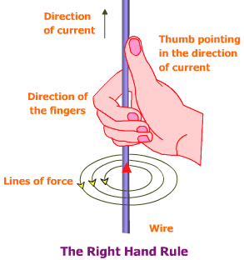
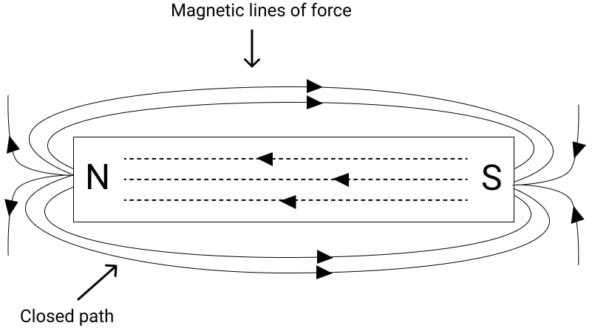
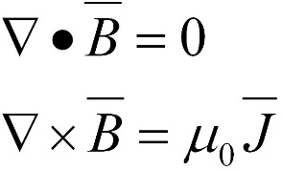
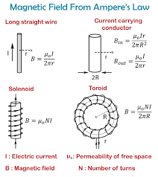
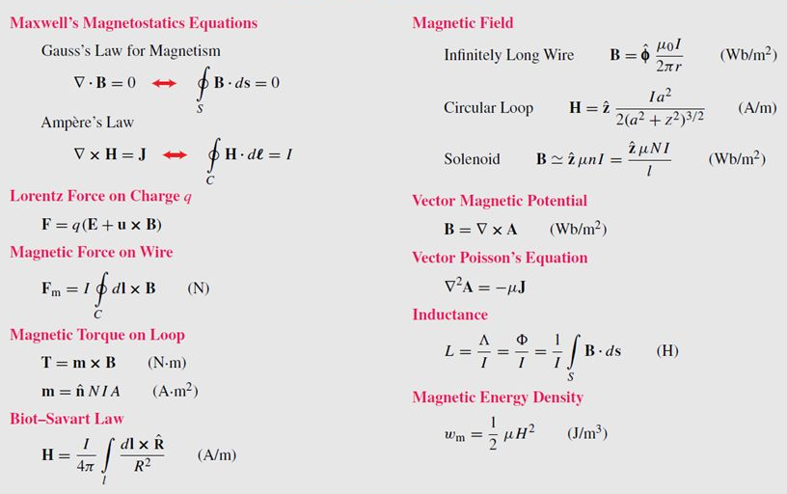
Summary
Divergence and Curl of Static Magnetic Field
Gauss’s Law in Magnetostatics
Ampere’s Law

Slide 27
References
A Text Book on Classic Engineering Physics, Amal Kr. Chakrabarty.
Engineering Electromagnetics, William H. Hayt, Jr., John A. Buck.
Field and Wave Electromagnetics, David K. Cheng, Pearson New International Edition.
Elements of Electromagnetics, Matthew N. O. Sadiku, Oxford University Press.
Electromagnetic Waves and Radiating Systems, Edward C. Jordan, Keith G. Balmain, Prentice-Hall Inc.

Slide 28
Thank you !

